Slide 1
Mapping Data Model to
Design Model

Slide 2
Introduction
Many application requires storing and retrieving information in a persistent storage mechanism, such as a relational database (RDB).
Designing of a persistent framework for storing persistent objects is required

Slide 3
Persistent Object:
  That requires persistent storage;
  for example in NextGen application, ProductSpecication data resides in a relational database. It must be brought into local memory during application use. Also it is needed to be saved in database again.
Stage Mechanism
  Object Database
  Relational Database
  Other

Slide 4
Persistent Framework
  A persistent framework is a general-purpose, reusable, and extendable set of types that provides functionality to support persistent objects.
  A persistent service or subsystem actually provides the service, and will be created with a persistent framework. It is usually written to work with RDB’s in which case it is also called an O-R mapping service.

Slide 5
Key Points
Mapping
  Develop a schema mapping; such as between a class object attributes and the fields in a record
Object Identity
  Records and object should have some unique identifiers to avoid duplication.
Database Mapper
  A pure fabrication database mapper is responsible for materialization and dematerialization
Materialization and Dematerialization
  Materialization is the act of transforming a non-object representation of data (for example record) from a persistent store into objects. Dematerialization is the opposite activity.

Slide 6
Key Points
Transaction state of object
  Know how of state (dirty) of an object
Transaction operations
  Commit and rollback
Lazy materialization
  Not all objects are materialized at once; a particular instance is only materialized on demand, when needed
Gateway Controller
  Use gateway controller to create connection with database

Slide 7
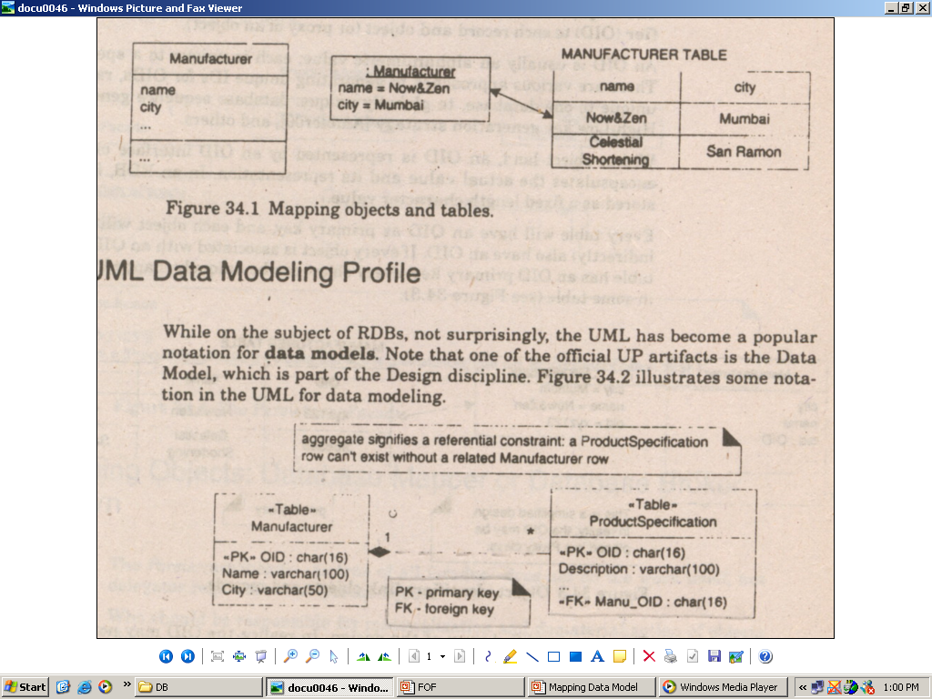
Pattern: Representation objects as Tables
Mapping objects and tables

Slide 8

UML Data Modelling example

Slide 9
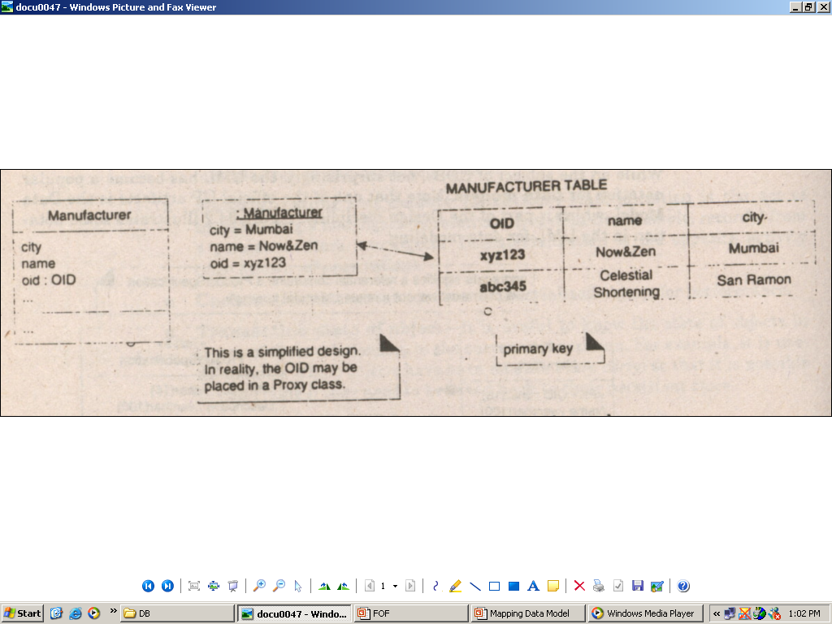
Pattern: Object Identifier
The object Identifier pattern proposes assigning an Object identifier (OID) to each record and object
Object identifier links objects and records

Slide 10
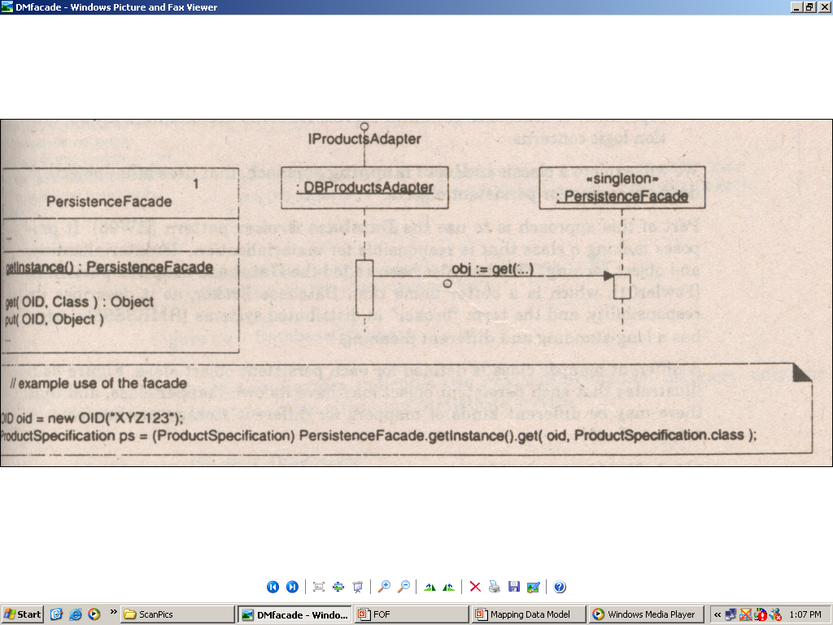
Pattern: Persistent Facade

Slide 11
Object
Class
Gateway
Controller
Persistent
Facade
Establish connection
DB
Establish connection
AddEMP (Id, Name)
AddEMP (Id, Name)

Slide 12
References
Applying UML and Patterns by Craig Larman
  Chapter 34: 34.5, 34.6, 34.7,34.8, 34.9

